Slide 1
Object Recognition

Slide 2
Patterns and Pattern Classes
Patterns and features
Pattern classes: a pattern class is a family of patterns that share some common properties
Pattern recognition: to assign patterns to their respective classes
Three common pattern arrangements used in practices are
  Vectors
  Strings
  Trees

Slide 3
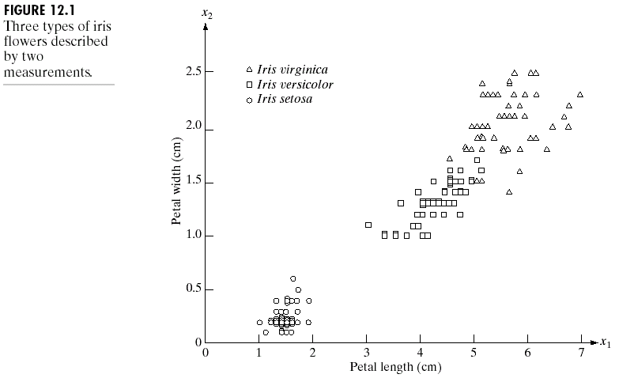
Patterns and Pattern Classes
Vector Example

Slide 4
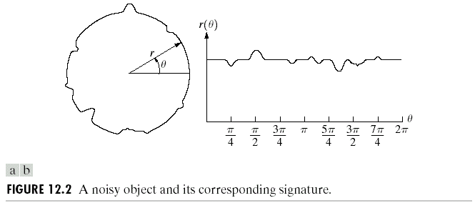
Patterns and Pattern Classes
Another Vector Example
Here is another example of pattern vector generation.
In this case, we are interested in different types of noisy shapes.

Slide 5
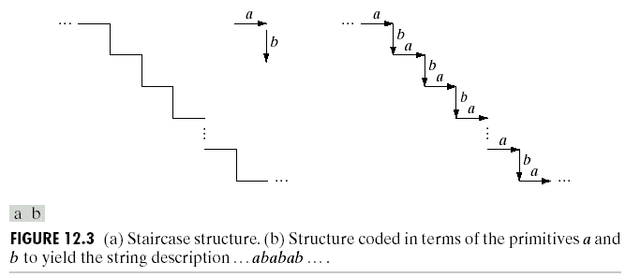
Patterns and Pattern Classes
String Example
String descriptions adequately generate patterns of objects and other entities whose structure is based on relatively simple connectivity of primitives, usually associated with boundary shape.

Slide 6
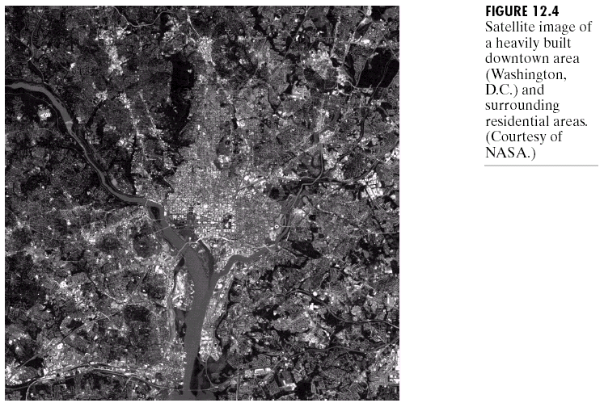
Patterns and Pattern Classes
Tree Example
Tree descriptions is more powerful than string ones.
Most hierarchical ordering schemes lead to tree structure.

Slide 7
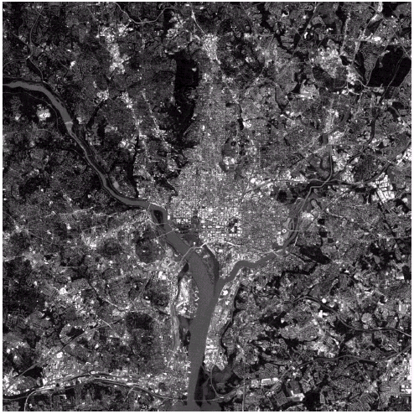
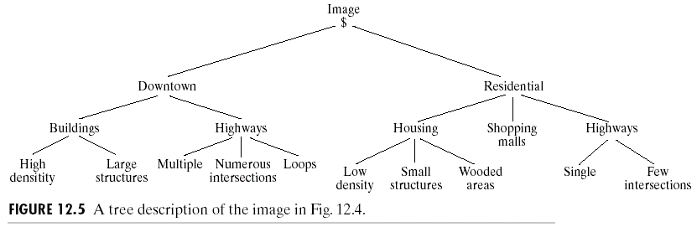
Patterns and Pattern Classes
Tree Example

Slide 8




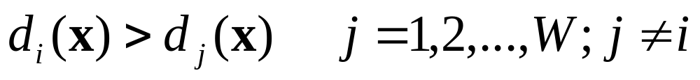

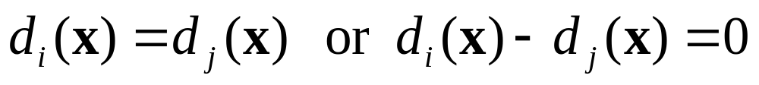
Recognition Based on
Decision-Theoretic Methods
Decision-theoretic approaches to recognition are based on the use decision functions.
Let represent an n-dimensional pattern vector. For W pattern classes , we want to find W decision functions with the property that, if a pattern x belongs to class , then
The decision boundary separating class and is given by

Slide 9
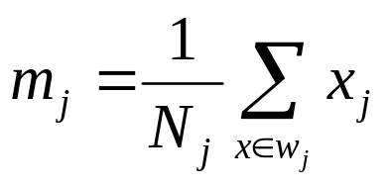
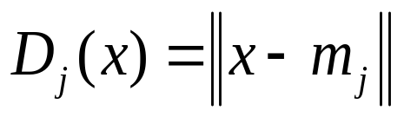
Minimum Distance Classifier
(Matching)
Suppose that we define the prototype of each pattern class to be the mean vector of the patterns of that class:
Using the Euclidean distance to determine closeness reduces the problem to computing the distance measures
j=1,2,…,W
j=1,2,…,W

Slide 10
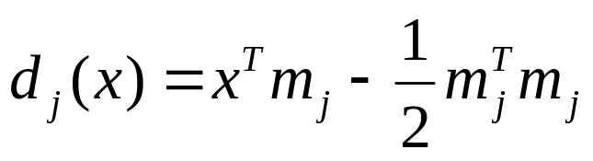
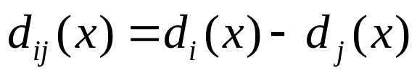
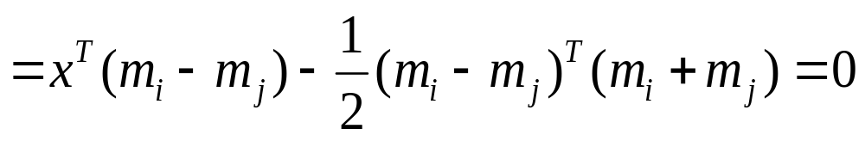
Minimum Distance Classifier
The smallest distance is equivalent to evaluating the functions
X is assigned to class ω_{i} if d_{i}(x) yeilds the largest value
The decision boundary between classes and for a minimum distance classifier is
j=1,2,…,W
j=1,2,…,W

Slide 11
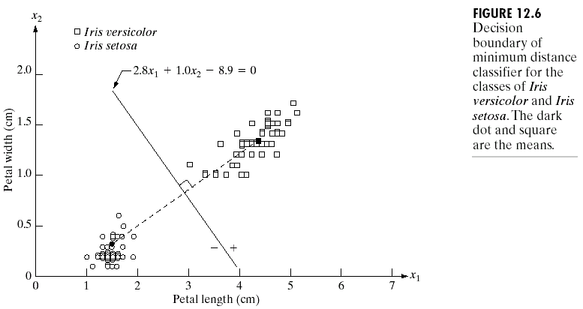
Recognition Based on Decision-Theoretic Methods
Matching
Minimum distance classifier

Slide 12
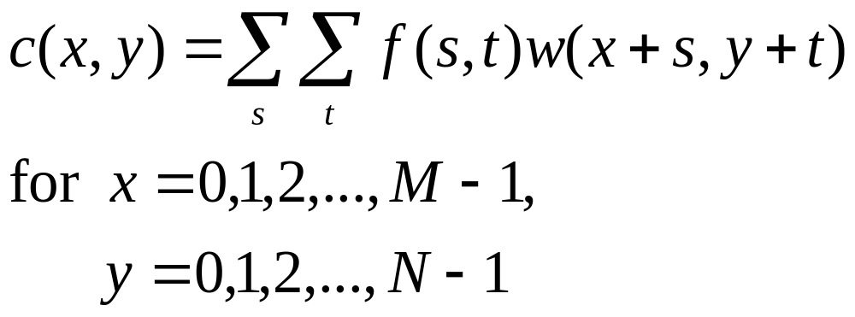
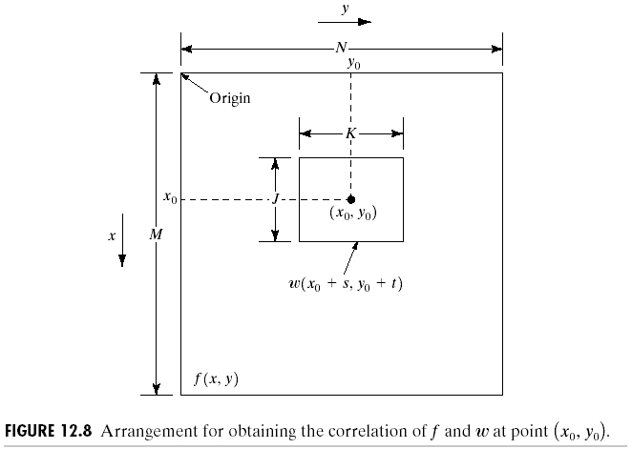
Recognition Based on Decision-Theoretic Methods
Matching by Correlation
The correlation between f(x,y) and w(x,y) is

Slide 13
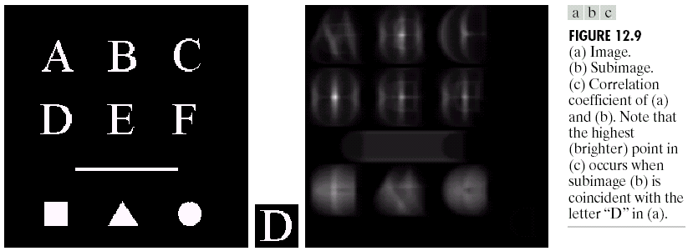
Recognition Based on Decision-Theoretic Methods
Matching by Correlation

